Slide 1
Convolutional Neural Networks (CNN)
Amos Azaria

Slide 2
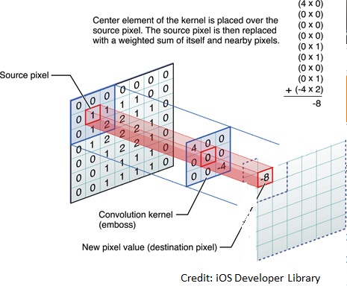
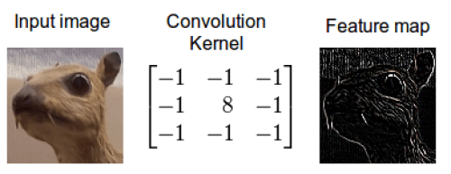
Convolutional Layers
Credit: iOS Developer Library
Credit: timdettmers.com

Slide 3
Convolution
The general idea comes from the way the brain processes images.
Convolution is very efficient in image processing, but is used also in different domains.
The word convolution means rolling / coiling together.

Slide 4
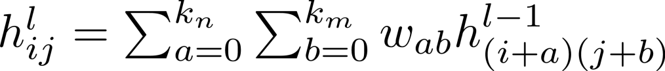
Convolution Layers
The weights are called kernels (size: k_{n} x k_{m})
All about weight sharing.
Instead of using new weights for every neuron, we use the same weights over and over again.
This makes the model more complex, without going too wild.
Convolution takes advantage of the structure of the input, and possible relations between adjacent pixels.

Slide 5
Convolutional Layers (Cont.)
In practice we stack many of these filters one on top of each-other, and get many results, which we keep processing with our network.
Each filter looks at different aspects of the image.
Some nice animations can be found here: https://github.com/vdumoulin/conv_arithmetic

Slide 6
Convolutional Layers (Cont.) Kernel Size = [3,3,1,3]
Input
Conv. Kernel
-1 | 1 | 1
0 | 2 | 1
-1 | 0 | -1
Output
7 | 2 | 0 | 5 | 5 | 8
3 | 8 | 0 | 0 | 0 | 9
6 | 8 | 3 | 3 | 0 | 0
2 | 9 | 0 | 3 | 1 | 6
2 | 9 | 2 | 3 | 8 | 3
1 | 2 | 7 | 8 | 8 | 8
2
-
8
7
14
22
-
11
5
0
-1 | 1 | 0
1 | 0 | 1
-1 | -1 | 1
19
-
11
-
3
-
1
19
-
9
3
7
-13 | -2 | -1 | 6
3 | -3 | 1 | 5
-5 | -1 | 4 | -2
15 | 2 | 6 | -4
1 | 1 | 1
0 | 0 | -1
0 | 0 | -1
6 | 4 | 10 | 9
8 | 2 | -1 | 3
15 | 8 | -3 | -6
2 | 1 | -12 | -1
Notes:
Stride = step

Slide 7
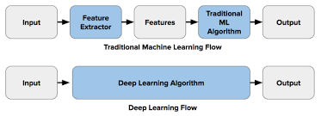
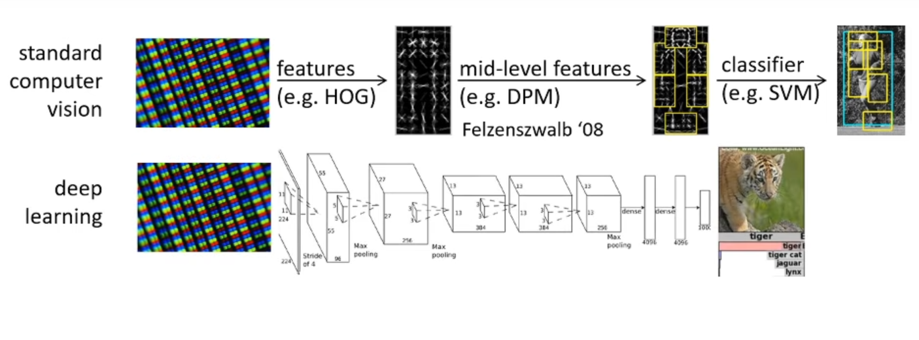
Traditional computer vision vs. deep learning
From: https://www.youtube.com/watch?v=IoF7D0qec0I

Slide 8
4-D Convolution Weights
In practice, the input to the convolution layer is many times 3-dimensions.
For example:
An image that has RGB channels.
A previous convolution layer's output.
In that case, in every kernel group, each kernel multiplies a different dimension and the results are summed up.
There may be multiple kernel groups and thus the result may have 3 dimensions as well.
Assume T kernel groups of (size: k_{n} x k_{m} x k_{q}) each:

Slide 9
Multiple Channel Input Kernel Size = [3,3,3,2]
Input
Conv. Kernel
Intermediate
Output
0 | 0 | 0 | 0 | 0 | 0
0 | 2 | 2 | 0 | 0 | 0
1 | 0 | 3 | 0 | 1 | 0
4 | 0 | 3 | 6 | 0 | 5
3 | 0 | 0 | 2 | 0 | 0
0 | 0 | 1 | 3 | 4 | 4
0 | 0 | 2
0 | 2 | 0
0 | -1 | 2
10 | 1 | 2 | -1
10 | 15 | -6 | 12
6 | 10 | 12 | 0
8 | 17 | 9 | 14
-16 | -5 | 10 | -21
-2 | 8 | -7 | 5
-2 | 0 | 10 | -13
-2 | 7 | 3 | -4
0 | 0 | 0 | 4 | 3 | 0
0 | 3 | 5 | 3 | 2 | 6
6 | 0 | 6 | 5 | 0 | 0
0 | 2 | 4 | 0 | 6 | 2
0 | 0 | 0 | 6 | 5 | 0
5 | 1 | 0 | 2 | 1 | 0
-10 | -6 | -4 | -8
-12 | -7 | 5 | 3
-2 | 0 | -6 | 1
0 | -10 | -6 | 0
1 | 0 | 0
0 | 0 | -2
0 | 0 | 0
0 | -2 | 0
0 | 0 | -2
2 | 0 | -2
-16 | 0 | 12 | -12
0 | 0 | -6 | -10
-6 | -10 | 4 | -14
-10 | 0 | 0 | -18
5 | 4 | 0 | 0 | 2 | 2
0 | 0 | 0 | 0 | 0 | 0
2 | 0 | 6 | 0 | 0 | 4
6 | 0 | 0 | 0 | 3 | 1
2 | 1 | 5 | 0 | 0 | 6
0 | 3 | 0 | 3 | 0 | 3
0 | 0 | -2
0 | 0 | 0
-2 | -2 | 2
4 | -6 | -4 | -2
-6 | 6 | -18 | -2
-12 | 4 | -6 | -4
-4 | -8 | 0 | -16
-2 | 16 | 1 | -6
9 | -1 | -1 | 15
3 | 11 | -8 | -10
6 | -17 | 22 | -17
0 | -2 | 1
2 | 0 | 0
0 | 0 | 0
0 | 10 | 5 | 0
11 | -7 | 8 | 12
6 | -3 | -2 | 0
0 | -8 | 6 | 2
0 | 0 | 0
2 | 0 | 0
0 | 2 | -1
-6 | 12 | 0 | -4
4 | 0 | 9 | 5
9 | 10 | 0 | -6
10 | -1 | 16 | -3

Slide 10
Back-Propagation
Don't forget that in order to train any network we must be able to calculate the gradient.
Luckily, back-propagation in CNN is quite similar to that of MLP.
Again, TensorFlow is handling this so we don't need to worry about it.

Slide 11
Convolution Layer Parameters
Filter size: e.g. 3x3
Number of filters (depth): e.g. (3x3)x15
Stride: how many steps in every dimension: usually [1,1,1,1] (could be e.g. [1,3,3,1]).
Padding (adding 0s):
Valid: No padding (as we have seen). E.g. input of 96x96 with 3x3 filter will result with an output image of 94x94
Same: e.g. input of 96x96 with 5x5 filter will result with an output image of 96x96. Before convolution zeros are added to the original image to make it 100x100.
(Full)

Slide 12
Bias and Activation Layer
We usually add a bias to each of the output matrices.
Usually after a convolution layer, comes an activation layer (e.g. Relu), just as we had in the fully connected network.

Slide 13
Max-Pooling
Input (usually conv. Output)
2x2 Max-pooling
7 | 2 | 0 | 5 | 5 | 8
3 | 8 | 0 | 0 | 0 | 9
6 | 8 | 3 | 3 | 0 | 0
2 | 9 | 0 | 3 | 1 | 6
2 | 9 | 2 | 3 | 8 | 3
1 | 2 | 7 | 8 | 8 | 8
8
5
9
9
3
6
9
8
8
There is also average pooling, which is less common.

Slide 14
Max-Pooling Motivation
We usually only care whether an "eye" was detected and not the average probability that an eye is at a certain location.
Suppose that in one level there are three detectors, one for g one for g, and one for g.
In the following level, We don't really care what type of g was detected, so we can simply take the max over all three detectors.
(while the second motivation may be easier to understand it is not exactly what is done when we deal with convolution)

Slide 15
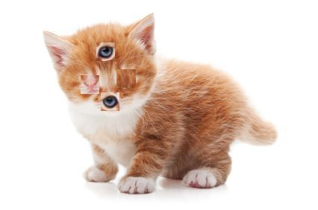
Problem with max-pooling
Credit: https://brandonmorris.dev/2017/11/16/dynamic-routing-between-capsules/
Notes:
Max-pooling looses the relation between the different features of the input, so if it detects an eye, it will say that it detected an eye, without “remembering” where exactly the eye actually appeared.

Slide 16
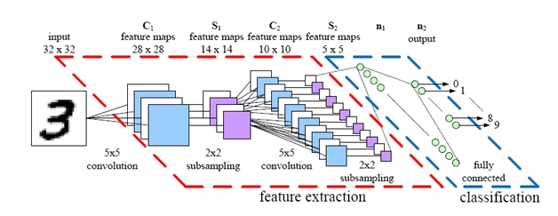
Stacking Layers
1000
How many weights?
Credit: parse.ele.tue.nl
5x5x4 + 4+ 4x5x5x12 + 12 + 5x5x12x1000 + 1000+ 1000x10+10

Slide 17
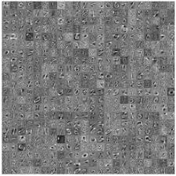
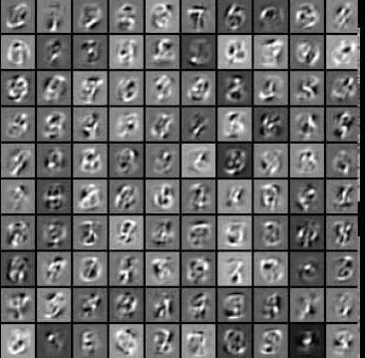
What do these layers actually learn?
These images are drawn using the activation maximization method. That is, we search for vectors that maximize the output of the relevant neuron
The first layers learn more basic concepts such as strokes. The higher layers start learning the different digits.

Slide 18
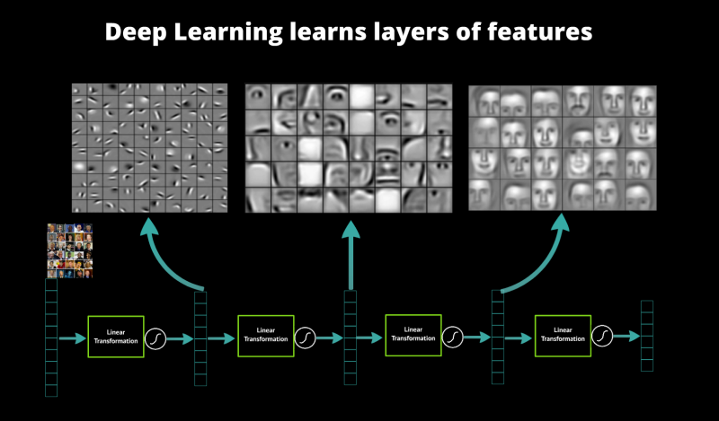
Face Recognition Example
Credit: http://www.cc.gatech.edu/~hays/compvision/results/proj6/yyeh32/index.html

Slide 19
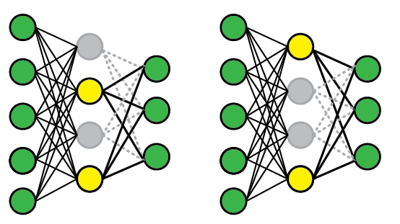
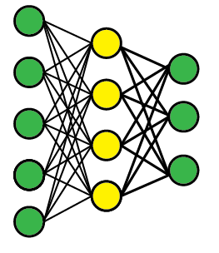
Dropout (Regularization)
Dropout makes learning more robust, prevents overfitting
Credit: Matt Krause

Slide 20
Dropout motivation
There are several explanations to why dorpout layers help:
Dropout makes it difficult for the network to overfit, because every time it sees the information flow from the input differently.
Dropout forces the network to succeed also when some neurons are missing, so it is forced to not put all its eggs in one basket, and all neurons must get to work. This may improve the total performance.
Dropout can be seen as an ensemble of an exponentially large number of neural networks (each with different connections).

Slide 21
CNN for MNIST
32 filters, 5x5 each (operate on 1 channel)
x = tf.placeholder(tf.float32, shape=[None, 784])
y_ = tf.placeholder(tf.float32, shape=[None, 10])
W_conv1 = tf.Variable(tf.truncated_normal([5, 5, 1, 32], stddev=0.1))
b_conv1 = tf.Variable(tf.constant(0.1, shape=[32]))
x_image = tf.reshape(x, [-1,28,28,1]) #if we had RGB, we would have 3 channels
h_conv1 = tf.nn.relu(tf.nn.conv2d(x_image, W_conv1, strides=[1, 1, 1, 1], padding='SAME') + b_conv1)
h_pool1 = tf.nn.max_pool(h_conv1, ksize=[1, 2, 2, 1], strides=[1, 2, 2, 1], padding='SAME')
W_conv2 = tf.Variable(tf.truncated_normal([5, 5, 32, 64], stddev=0.1))
b_conv2 = tf.Variable(tf.constant(0.1, shape=[64]))
h_conv2 = tf.nn.relu(tf.nn.conv2d(h_pool1, W_conv2, strides=[1, 1, 1, 1], padding='SAME') + b_conv2)
h_pool2 = tf.nn.max_pool(h_conv2, ksize=[1, 2, 2, 1], strides=[1, 2, 2, 1], padding='SAME')
h_pool2_flat = tf.reshape(h_pool2, [-1, 7*7*64])
W_fc1 = tf.Variable(tf.truncated_normal([7 * 7 * 64, 1024], stddev=0.1))
b_fc1 = tf.Variable(tf.constant(0.1, shape=[1024]))
h_fc1 = tf.nn.relu(tf.matmul(h_pool2_flat, W_fc1) + b_fc1)
keep_prob = tf.placeholder(tf.float32)
h_fc1_drop = tf.nn.dropout(h_fc1, keep_prob)
W_fc2 = tf.Variable(tf.truncated_normal([1024, 10], stddev=0.1))
b_fc2 = tf.Variable(tf.constant(0.1, shape=[10]))
pred=tf.nn.softmax(tf.matmul(h_fc1_drop, W_fc2) + b_fc2)
Why 7x7x64?
Fully connected level (1024 neurons)
Another FC level, matching 10 digits

Slide 22
CNN for MNIST (Training)
cross_entropy = tf.reduce_mean(-tf.reduce_sum(y_ * tf.log(pred), reduction_indices=[1]))
train_step = tf.train.AdamOptimizer(1e-4).minimize(cross_entropy) #uses moving averages momentum
correct_prediction = tf.equal(tf.argmax(pred,1), tf.argmax(y_,1))
accuracy = tf.reduce_mean(tf.cast(correct_prediction, tf.float32))
sess = tf.InteractiveSession()
sess.run(tf.global_variables_initializer())
for i in range(20000):
batch = mnist.train.next_batch(50)
if i%100 == 0:
train_accuracy = accuracy.eval(feed_dict={x:batch[0], y_: batch[1], keep_prob: 1.0})
print("step %d, training accuracy %g"%(i, train_accuracy))
train_step.run(feed_dict={x: batch[0], y_: batch[1], keep_prob: 0.5})
print("test accuracy %g"%accuracy.eval(feed_dict={x: mnist.test.images, y_: mnist.test.labels, keep_prob: 1.0}))
Adam is a gradient descent with some enhancements. It uses the moving average of the previous gradients + normizing by root mean squared error. It usually works better than plain SGD. See following slides.
Result:
…
step 19700, training accuracy 1 step 19800, training accuracy 1 step 19900, training accuracy 1 test accuracy 0.9908!!
Notes:
Adam is a gradient descent with some enhancements. It uses the moving average of the previous gradients to determine its next learning rate.
It may require less steps, but may take longer to compute each step.

Slide 23
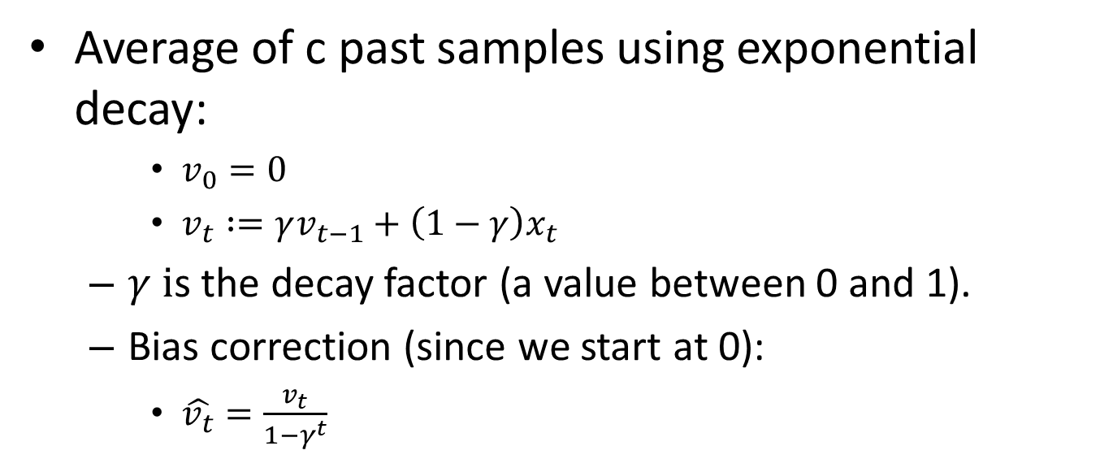
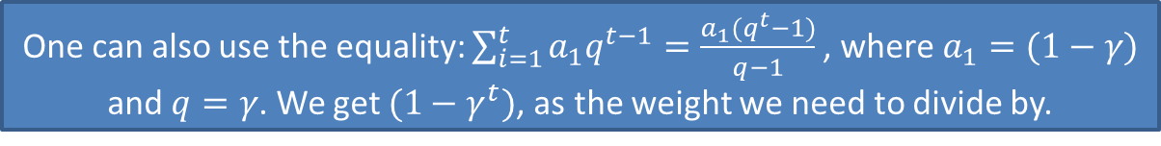
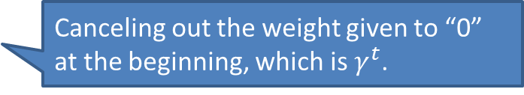
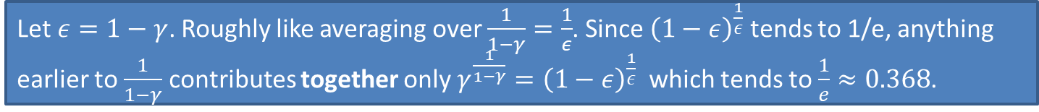
Exponentially Weighted Moving Average
Average of c past samples using exponential decay:
$v_{0}=0$
$v_{t} :=γv_{t−1}+\left(1−γ\right)x_{t}$
$γ i$s the decay factor (a value between 0 and 1).
Bias correction (since we start at 0):
$\hat{v_{t}}=\frac{v_{t}}{1−γ^{t}}$
Canceling out the weight given to “0” at the beginning, which is $γ^{t}$.
One can also use the equality: $\sum_{i=1}^{t}{a_{1}q^{t−1}}=\frac{a_{1}(q^{t}−1)}{q−1}$, where $a_{1}=(1−γ)$ and $q=γ$. We get $(1−γ^{t})$, as the weight we need to divide by.
Let $ε=1−γ$. Roughly like averaging over $\frac{1}{1−γ}=\frac{1}{ε}$. Since ${\left(1−ε\right)}^{\frac{1}{ε}}$ tends to 1/e, anything earlier to $\frac{1}{1−γ}$ contributes together only $γ^{\frac{1}{1−γ}}={\left(1−ε\right)}^{\frac{1}{ε}}$ which tends to $\frac{1}{e}≈0.368$.

Slide 24
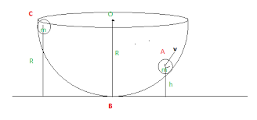
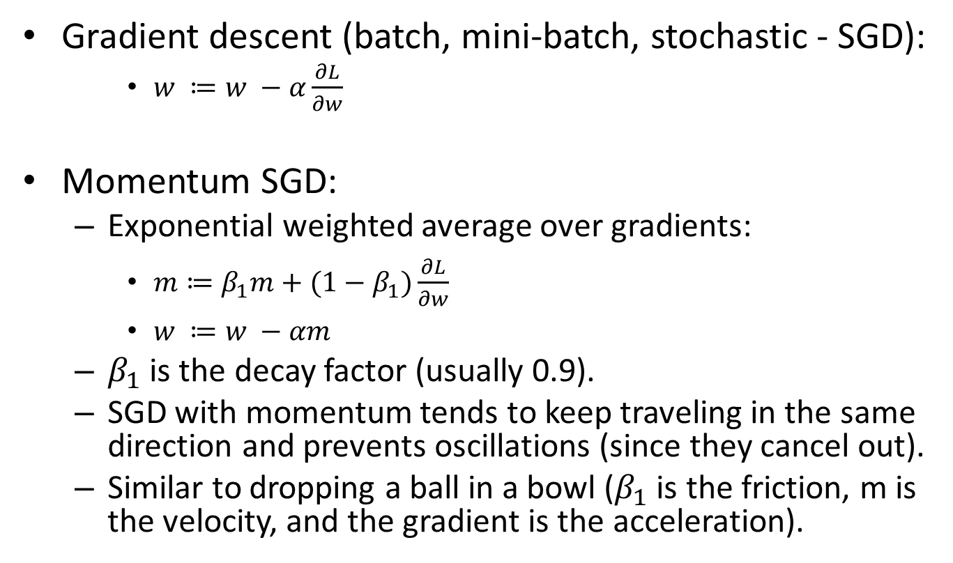
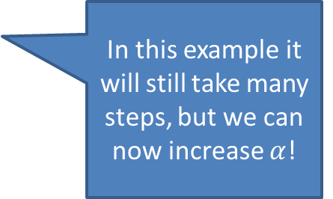
Optimization Algorithms
Gradient descent (batch, mini-batch, stochastic - SGD):
$w ≔w −α\frac{∂L}{∂w}$
Momentum SGD:
Exponential weighted average over gradients:
$m≔β_{1}m+{(1−β}_{1})\frac{∂L}{∂w}$
$w ≔w −αm$
$β_{1}$ is the decay factor (usually 0.9).
SGD with momentum tends to keep traveling in the same direction and prevents oscillations (since they cancel out).
Similar to dropping a ball in a bowl ($β_{1}$ is the friction, m is the velocity, and the gradient is the acceleration).
In this example it will still take many steps, but we can now increase $α$!

Slide 25

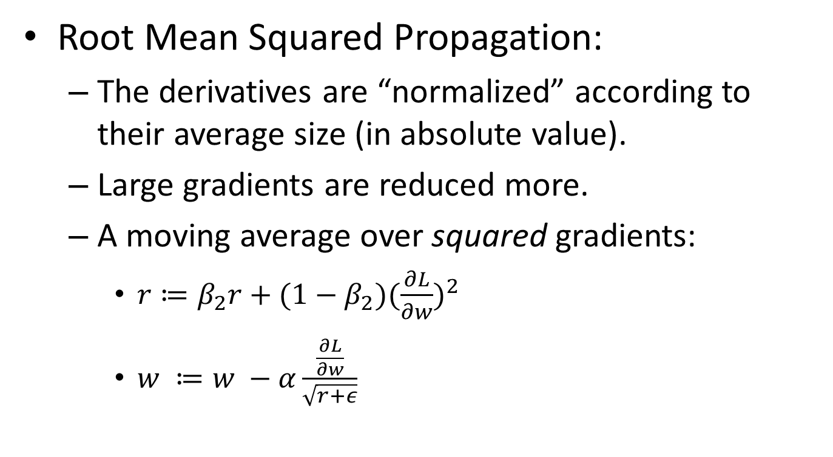
RMSProp
Root Mean Squared Propagation:
The derivatives are “normalized” according to their average size (in absolute value).
Large gradients are reduced more.
A moving average over squared gradients:
$r≔β_{2}r+{(1−β}_{2}){(\frac{∂L}{∂w})}^{2}$
$w ≔w −α\frac{\frac{∂L}{∂w}}{\sqrt{r+ε}}$
We add $ε$ to avoid 0 division

Slide 26
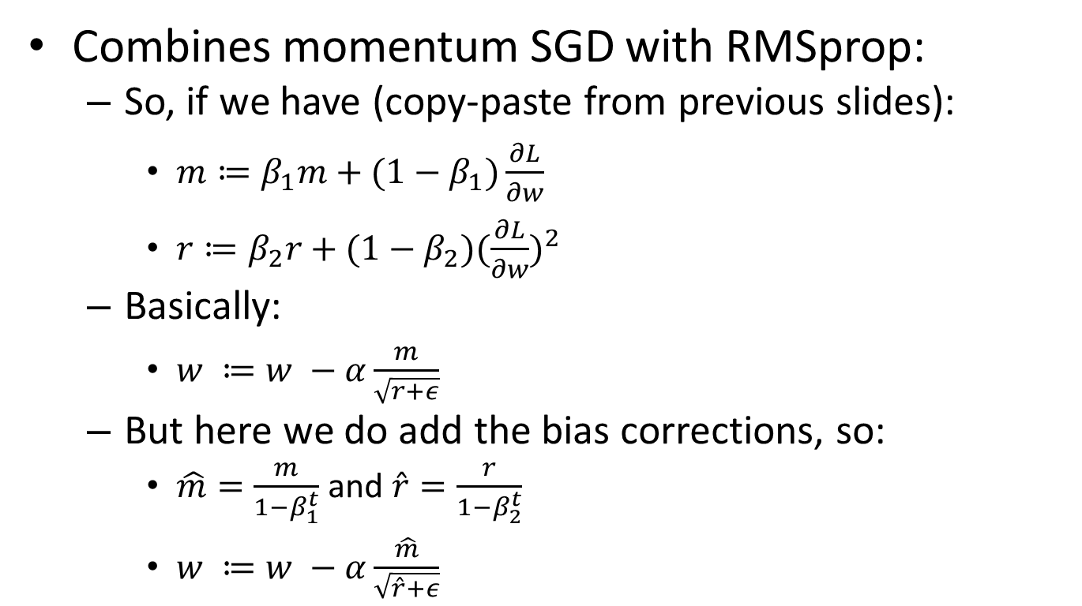
Adam optimizer
Combines momentum SGD with RMSprop:
So, if we have (copy-paste from previous slides):
$m≔β_{1}m+{(1−β}_{1})\frac{∂L}{∂w}$
$r≔β_{2}r+{(1−β}_{2}){(\frac{∂L}{∂w})}^{2}$
Basically:
$w ≔w −α\frac{m}{\sqrt{r+ε}}$
But here we do add the bias corrections, so:
$\hat{m}=\frac{m}{1−β_{1}^{t}}$ and $\hat{r}=\frac{r}{1−β_{2}^{t}}$
$w ≔w −α\frac{\hat{m}}{\sqrt{\hat{r}+ε}}$

